Slide 1
Multivariate Time Series Analysis – Session2
Sreekanth Tadakaluru

Slide 2
Session Structure
Theory & VAR Fundamentals
VAR Implementation & Case Study 1 (Economics)
VARMA Models & Deep Learning Introduction
Advanced Case Study 2 (Energy Forecasting)
Learning Objectives
✓ Master multivariate time series concepts ✓ Implement VAR/VARMA in Python ✓ Apply deep learning for forecasting ✓ Analyse real-world datasets

Slide 3
Key Concepts in Multivariate TS
Stationarity
Definition: Statistical properties constant over time
Check: Augmented Dickey-Fuller (ADF) test
Solution: Differencing, detrending
Granger Causality
Does X help predict Y?
Not true causality, but predictive relationship
Used for model specification
Cointegration
Long-run equilibrium relationship
Important for non-stationary series
Leads to Vector Error Correction Models (VECM)

Slide 4
What is VAR?
Vector Autoregression is a multivariate generalization of univariate autoregression
Key Features:
✓ Each variable is a function of past values of itself AND other variables ✓ Captures dynamic relationships ✓ No need to specify "dependent" vs "independent" variables ✓ All variables treated symmetrically (endogenous)
Developed by:
Christopher Sims (1980) - Nobel Prize winner

Slide 5
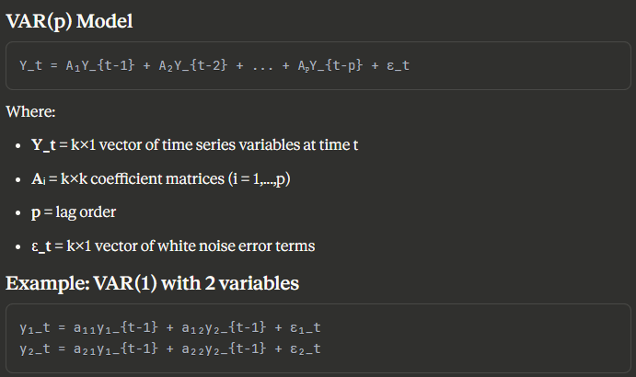
VAR Model - Mathematical Formulation

Slide 6
VAR Model Components
Endogenous Variables (Y_t)
Variables to be modeled
Each depends on past values of all variables
Example: [GDP, Inflation, Interest Rate]
Lag Order (p)
Number of past periods to include
Selected using IC (AIC, BIC)
Trade-off: fit vs. Complexity
Coefficient Matrices (A₁, A₂, ..., Aₚ)
Capture relationships between variables
Estimated using OLS (each equation separately)
Error Terms (ε_t)
White noise
Can be correlated across equations

Slide 7
VAR Model Assumptions
Stationarity
All series must be stationary
Check with ADF test
Difference if necessary
No Serial Correlation in Residuals
Test with Durbin-Watson, Ljung-Box
Indicates correct lag order
Homoscedasticity
Constant variance of errors
Check with residual plots
No Multicollinearity
Variables should not be perfectly correlated
Can still have some correlation (that's the point!)

Slide 8
General Applications of VAR
Economic Policy Analysis
Monetary policy effects on economy
Fiscal stimulus impact assessment
Interest rate transmission mechanisms
Financial Markets
Stock-bond relationships
Commodity price dynamics
Currency co-movements
Macroeconomic Forecasting
GDP, inflation, unemployment projections
Business cycle analysis
Leading indicator systems
Other Applications
Neuroscience: Brain signal analysis
Climate: Temperature-rainfall patterns
Marketing: Sales-advertising dynamics

Slide 9
VAR Forecasting Process
Model Estimation
Generate Forecasts
Compute Confidence Intervals
Based on forecast error variance
Typically 68%, 95% confidence levels
Widen as forecast horizon increases

Slide 10
Impulse Response Functions (IRF)
What is IRF?
Definition: Response of system to a shock in one variable
Key Uses:
Understand dynamic effects of shocks
Measure how long effects persist
Quantify magnitude of impact
Example Question:
"If interest rates increase by 1%, how do GDP and inflation respond over the next 8 quarters?"
IRF Visualization
X-axis: Time periods after shock
Y-axis: Response magnitude
Multiple lines: Different variables' responses
Confidence bands show uncertainty

Slide 11
Forecast Error Variance Decomposition (FEVD)
What is FEVD?
Purpose: Decompose forecast error variance into contributions from each variable
Interpretation:
"What percentage of forecast error in GDP is due to shocks in:
GDP itself? (e.g., 70%)
Inflation? (e.g., 20%)
Interest rates? (e.g., 10%)"
Applications:
Identify most influential variables
Understand system dynamics
Guide policy interventions
Note: FEVD depends on ordering of variables (Cholesky decomposition)

Slide 12
Residual Analysis
✓ White noise test (Ljung-Box)
✓ Normality test (Jarque-Bera)
✓ No autocorrelation
Stability Test
✓ All eigenvalues inside unit circle
✓ Ensures forecast convergence
✓ Checked with roots plot
Granger Causality Tests
Which variables help predict others?
Guides model simplification
Out-of-Sample Validation
Compare forecasts with held-out data
RMSE, MAE metrics

Slide 13
Lag Order Selection
Information Criteria
Try p = 0, 1, 2, ..., max_lags
Select p with lowest AIC/BIC
Likelihood Ratio Test
Sequential testing of nested models
Final Prediction Error (FPE)
Balances fit and complexity
Practical Considerations:
Too few lags: Omitted variable bias
Too many lags: Overfitting, loss of degrees of freedom
Rule of thumb: Start with p = 4 for quarterly data, p = 12 for monthly

Slide 14
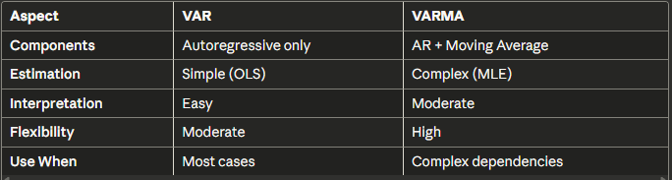
VAR vs VARMA
VARMA Advantage:
Can model same process with fewer parameters than VAR
VAR Advantage:
Easier to estimate and interpret, usually sufficient

Slide 15
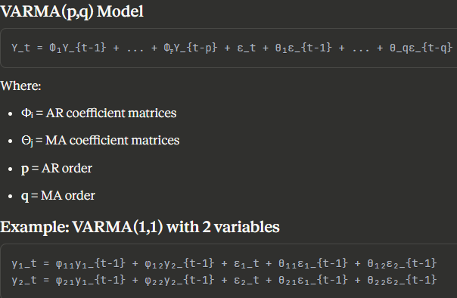
VARMA Model - Mathematical Form

Slide 16
VARMA - When to Use?
More Parsimony Needed
VAR requires too many parameters
Limited data available
Complex Dependencies
Relationships not captured by VAR alone
MA component improves fit significantly
Model Comparison Shows Benefit
AIC/BIC clearly favour VARMA over VAR
Challenges:
Identification Issues
Multiple parameter combinations can fit same model
Requires constraints
Estimation Complexity
Non-linear optimization
Convergence problems
Limited Software Support
Fewer implementations than VAR

Slide 17
VARMA Forecasting
State Space Representation
Convert VARMA to state space form for forecasting
Kalman Filter
Optimal forecasting for state space models
Recursively updates forecasts
Forecast Generation
Similar to VAR but accounts for MA component
Need to estimate future error terms
Confidence Intervals
Computed from state space covariance
Account for both AR and MA uncertainty
Practical Note: Often VAR with more lags performs similarly to VARMA with fewer parameters

Slide 18
Deep Learning for Time Series - Overview
Traditional Methods (VAR/VARMA) Excel When:
Small to medium datasets
Linear relationships dominate
Interpretability is crucial
Statistical rigor needed
Deep Learning Excels When:
Large datasets (1000s+ observations)
Non-linear complex patterns
High-dimensional data
Automatic feature extraction needed
Hybrid Approach: Best of Both Worlds
Combine statistical models with DL ensembles

Slide 19
Deep Learning Architectures for TSF
Recurrent Neural Networks (RNN)
Long Short-Term Memory (LSTM)
Purpose: Learn long-term dependencies
Key Feature: Memory cells with gates
Use Case: Sequential patterns, long sequences
Gated Recurrent Unit (GRU)
Purpose: Simplified LSTM
Key Feature: Fewer parameters, faster training
Use Case: Similar to LSTM, when speed matters

Slide 20
More DL Architectures
Convolutional Neural Networks (CNN)
For Time Series: 1D convolutions
Strength: Detecting local patterns
Use Case: Pattern recognition, feature extraction
Transformer Models
Innovation: Self-attention mechanism
Strength: Parallel processing, long-range dependencies
Examples: Temporal Fusion Transformer (TFT), Informer
Use Case: Complex multivariate forecasting
Hybrid Models
DeepAR: Probabilistic forecasting with LSTM
N-BEATS: Neural basis expansion (interpretable DL)
Prophet + NN: Statistical + Neural hybrid

Slide 21
When to Use Which Model?
Small Data (<1000 obs) + Linear
→ VAR / VARMA
Small Data + Non-linear
→ ARIMA + XGBoost / LightGBM
Large Data + Linear
→ VAR with regularization / VECM
Large Data + Non-linear + Complex
→ LSTM / Transformer
Need Interpretability
→ VAR + IRF / N-BEATS
Multiple Seasonalities
→ Prophet / TBATS / Hybrid
Uncertainty Quantification
→ Bayesian VAR / DeepAR

Slide 22
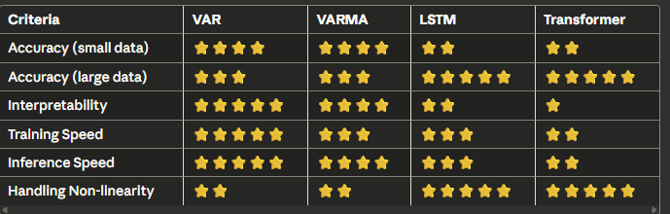
Model Comparison - Practical View

Slide 23
Best Practices for Multivariate TSF
Data Preparation
✓ Check stationarity for all series ✓ Handle missing values appropriately ✓ Scale/normalize data ✓ Split: Train (70%), Validation (15%), Test (15%)
Model Building
✓ Start simple (VAR) then increase complexity ✓ Use cross-validation for time series ✓ Always validate assumptions ✓ Compare multiple models
Evaluation
✓ Use multiple metrics (RMSE, MAE, MAPE) ✓ Evaluate on holdout set ✓ Check residuals ✓ Business validation

Slide 24
Common Pitfalls to Avoid
❌ Data Leakage
Don't use future information in training
Be careful with data transformations
❌ Ignoring Stationarity
Non-stationary data leads to spurious relationships
Always test and transform
❌ Overfitting
Too many lags or parameters
Use regularization or simpler models
❌ Wrong Evaluation
Don't use simple train-test split randomly
Preserve temporal order
❌ Ignoring Domain Knowledge
Models should make business sense
Validate with experts

Slide 25
Python Libraries Ecosystem
Statistical Models
statsmodels # VAR, VARMA, SARIMAX
pmdarima # Auto-ARIMA
arch # GARCH models
Deep Learning
tensorflow/keras # LSTM, GRU, CNN
pytorch # Flexible DL framework
pytorch-forecasting # Time series DL toolkit
darts # Unified forecasting library
Utilities
pandas # Data manipulation
numpy # Numerical computing
matplotlib/seaborn # Visualization
scikit-learn # Preprocessing, metrics

Slide 26
Case Study 1 - Introduction
Economic Analysis: Macroeconomic Interdependencies
Dataset:
Source: Federal Reserve Economic Data (FRED)
Variables: GDP Growth, Inflation, Unemployment, Interest Rate
Frequency: Quarterly
Period: 1960-2024 (~260 observations)
Objectives:
Model relationships between macro variables
Test Granger causality
Forecast 8 quarters ahead
Analyze impulse responses
Business Question:
"How do interest rate changes affect GDP and unemployment?"

Slide 27
Case Study 2 - Introduction
Energy Demand Forecasting: Multi-Model Comparison
Dataset:
Source: PJM Interconnection (Energy Grid)
Variables: Hourly electricity demand, temperature, humidity, day/hour features
Frequency: Hourly
Period: 6 months (~4,400 observations)
Objectives:
Compare VAR, VARMA, and LSTM
24-hour ahead forecast
Evaluate model performance
Deployment recommendations
Business Question:
"Which model should we deploy for real-time energy demand forecasting?"

